Slide 1
Internet of Things
Smart Irrigation
Carlo Carugno
Christian Tedesco
Ernest Halili
Asseda

Slide 2
Analysis of the problem
Water is an important resource for our planet.
Everyday tons of water are wasted for plants.
Overwatering is one of the most common cases.
Objective and possible solution
Our goal is to develop a small, inexpensive, smart product
that helps monitoring and avoiding water waste used for
plants irrigation.

Slide 3
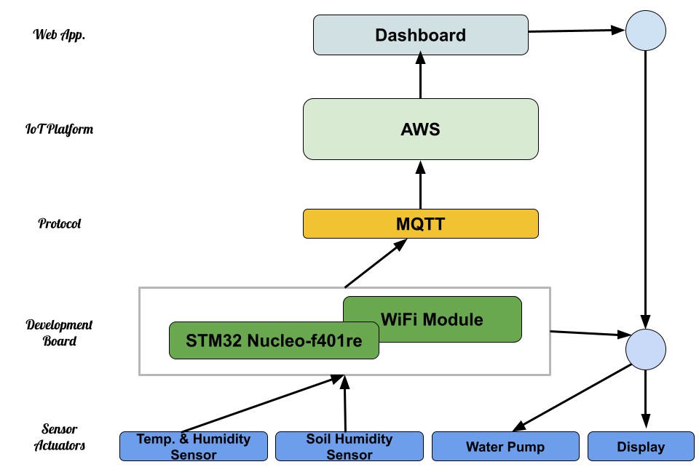
Components
In the following structure all the components used are illustrated:

Slide 4
Data collection by Sensors
Adafruit Seesaw Soil Moisture Sensor:
• Operating voltage: 3.3 ~ 5.5 VDC
• Output voltage: 0 ~ 3.0 VDC
• Operating Current: 5mA
• Interface: PH2.54-3P
DHT 22 Temperature and Humidity Sensor:
• Operating range: humidity 0-100%RH / temperature -40~80 Celsius
• Accuracy humidity +-2%RH(Max +-5%RH); / temperature <+-0.5 Celsius
• Resolution : humidity 0.1%RH / temperature 0.1 Celsius
• Repeatability humidity +-1%RH / temperature +-0.2 Celsius

Slide 5
Data provided to Actuators
Submersible Water Pump
• Operating Voltage: 3-5 V
• Operating Current: 100 - 200 mA
• Water Inlet Entrance Dimension: 5.0 mm
• Water Outlet Exit Outer Diameter: 7.5 mm
• Water Outlet Exit Inner Diameter: 4.5 mm
• Head Distance: 0.3 - 0.8 meter
• Flow Rate: 1.2 - 1.6 Liter per minute
2-Channel 5V Relay Module
• Contact current 10A and 250V AC or 30V DC
• Each channel has indication LED
• Coil voltage 12V per channel
• Kit operating voltage 5-12 V
• Input signal 3-5 V for each channel
• Three pins are normally open and closed for each channel
OLED Display
• Resolution: 128 x 64
• Active Area: 29.42 x 14.7 mm
• Operating Voltage: 3.3V - 5.0V
• Logic Voltage: 3.3V
• Pixel Pitch: 0.23 x 0.23 (mm)
• Pixel Size: 0.21 x 0.21 (mm)
• Operating Current: 20ma
• Operating Temperature: -40~70℃

Slide 6
Data collection intelligence
Temperature and Humidity Sensor
Based on the value of this sensor, we determine the weather conditions of the environment
by checking the external temperature and the level of humidity in the air.
Soil Moisture Sensor
This sensor is inside the ground and is used to monitor the ground’s moisture level and
its temperature.
Statistics Data
Using trend values from measurements we can estimate after how much time the plants
need to be irrigated.

Slide 7
Interaction with the environment
We are going to monitor specific parameters and based on those ones, we are acting in order to keep
the environment in good conditions.
If the soil is arse the relay will activate the pump that will start irrigating water from a container put nearby.
The quantity of water given is decided by the level of soil humidity which is shown in a OLED display and
in a dashboard.
Considering the environment temperature we’ll decide how much time will pass between measures.
If the temperature is too high the rate of measures will increase since the soil will dry out earlier.

Slide 8
Effectiveness into the environment
Water wasting is maybe the biggest error that people do when they irrigate plants because is a waste of money,
waste of resources and dangerous for the growth of plants.
When a plant receives too much water it can have multiple problem that can reduce the level of oxygen produced or even kill it. The opposite can cause the progressive decay that can lead to withering!
To reduce the water consumption we need a system that acts in a rapid way, in order to have such fast response and keep a good soil condition it’s necessary to have a real-time monitoring.
This also is particularly useful when you are managing multiple plants, by using this system you are giving the specific amount of water to each plant avoiding the growth of “bad” plants.
The product is used also in a situation where you are not close to the environment, it provides all the details that are needed for having a remote control over the growth.
Measurements of our actions
Quantity of water used from the container every week(=litre/week), knowing the capacity of the container.
The soil will always be watered, we are going to measure the average moisture based on the values that sensors are going to measure.
Another way to measure effectiveness of humidity is to measure the range of values given from the sensors.

Slide 9
Constraints and Metrics of the System
Power consumption is not a big problem since the whole system is activated only in short periods of time.
Network connection limitations are present in the system it could be hosted in remote areas.
For less power consumption the system will be provided with a battery.
Performances will be evaluated using available tools in market and statistics found on internet.
Once the system will be ready to work, it will be tested in different scenarios: different varieties of plants and several weather conditions.
An example of troubleshooting software for latency is Wireshark, it can be used to test end to end communication and check the network’s performance.
We are going to sample:
Sensors (periodically)
Bandwidth and latency
Power Consumption(use of battery)

